Slide 1
CO227 PROJECT MID EVALUATION
FINITE ELEMENT BASED
STRUCTURAL ANALYSIS

Slide 2
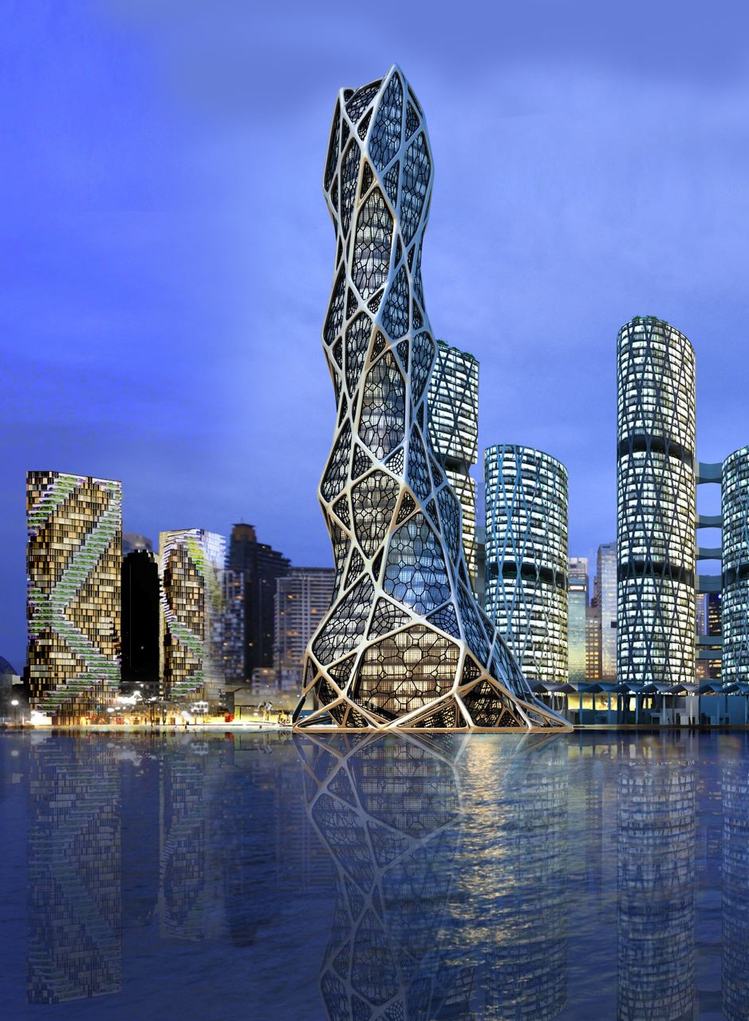
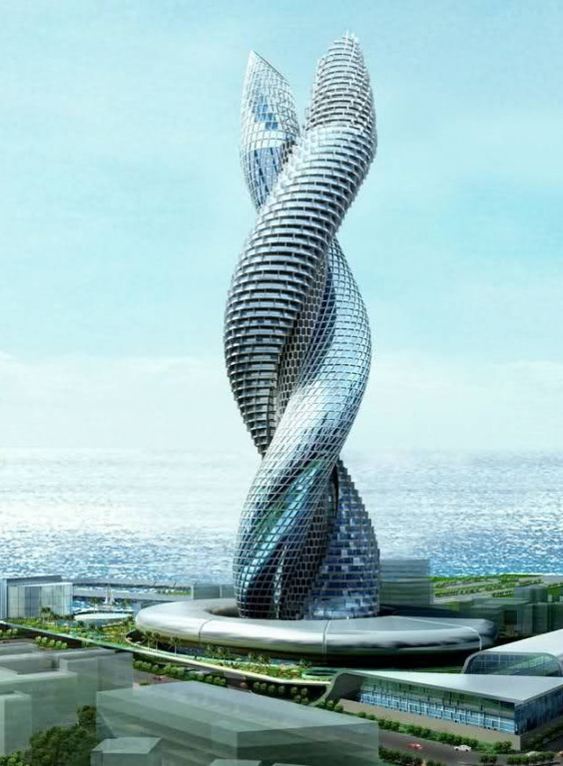
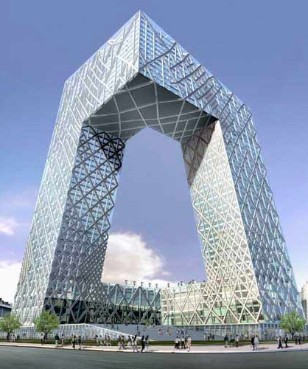
WHAT YOU SEE
Bionic tower, Abu Dhabi
Cobra tower, Kuwait
CCTV Headquarters, China

Slide 3
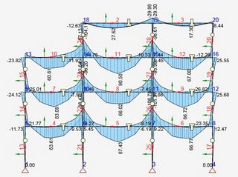
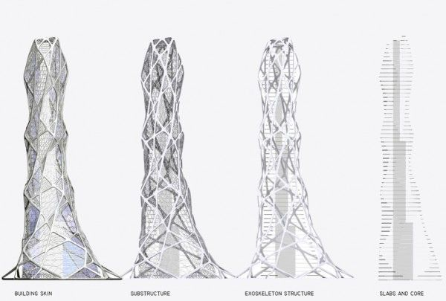
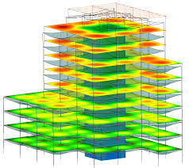
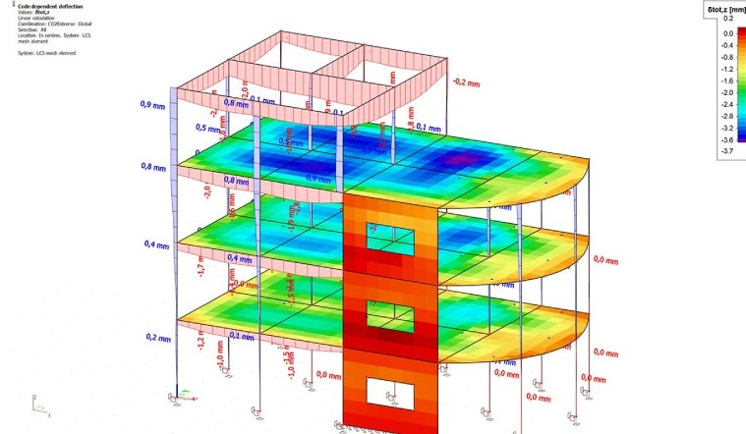
WHAT STRUCTURAL ENGINEERS SEE

Slide 4
HOW COMPLEX ?

Slide 5


LINEAR
NON-LINEAR
F = K e
K is Constant
Small loading conditions
K Varies
Extreme loading conditions
Widely used software : SAP 2000
Widely used software : Opensees

Slide 6
Interaction of
Axial force - Bending moment

Slide 7
Using the novel formulation developed by
the Department of Civil Engineering
Interaction of
Axial force - Bending moment - Shear force

Slide 8
A SIMPLE OVERVIEW
OF THE SOFTWARE

Slide 9
Nodes
Beams
Columns
Simple 3 story building using reinforced concrete frames

Slide 10
Degrees of freedom
z
m
x
y
Structure Level
Element Level

Slide 11
Concrete
Fibers
Steel
Fibers
Element
Section Level
Fiber Level

Slide 12
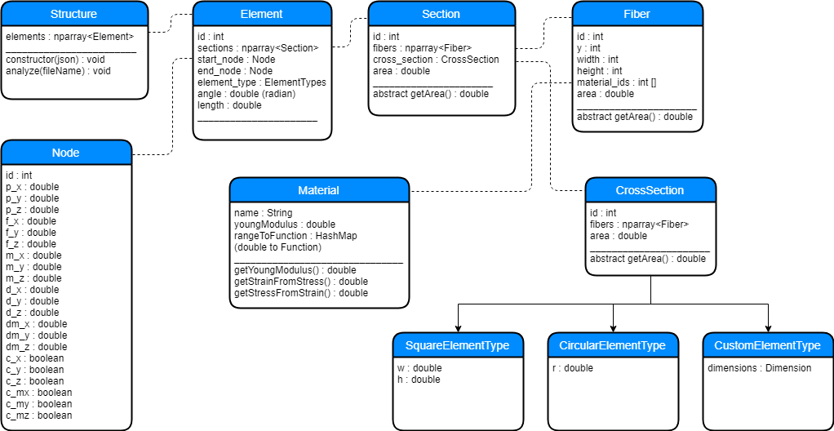
CLASS DIAGRAM

Slide 13
PROJECT PLAN AND PROGRESS

Slide 14
NEXT STEPS
Improvements
- Extending for 3D structures
Optimizations
- Parallelizing calculations
- GPU processing

Slide 15
DEMONSTRATION

Slide 16
Q & A

